Slide 1
Pointers

Slide 2
Definition
Pointer can be used to store the memory address of other variables, functions, or even other pointers.
Pointers store the memory addresses, their size is independent of the type of data they are pointing to. This size of pointers only depends on the system architecture.

Slide 3
How to Use Pointers?
The use of pointers : Pointer Declaration Pointer Initialization

Slide 4
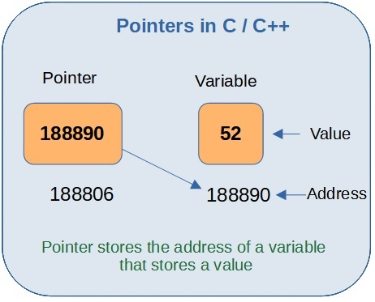
Pointers

Slide 5
1. Pointer Declaration
To declare a pointer, we use the ( * ) dereference operator before its name
datatype * ptr;
ptr is the name of the pointer.
datatype is the type of data it is pointing to.

Slide 6
2. Pointer Initialization
Pointer initialization is the process where we assign some initial value to the pointer variable ( & ) addressof operator to get the memory address of a variable and then store it in the pointer variable.
int var = 10;
int * ptr;
ptr = &var;

Slide 7
2. Pointer Initialization
Can also declare and initialize the pointer in a single step. This method is called pointer definition
int *ptr = &var;

Slide 8
Program
#include <stdio.h> int main() { int var = 5; printf(“var: %d\n”, var); printf(“address of var: %p”, &var); return 0; }

Slide 9
Example
Output
Var: 5 address of var: 2686778

Slide 10
Dereferencing
Dereferencing a pointer is the process of accessing the value stored in the memory address specified in the pointer

Slide 11
Example 1
#include <stdio.h> void main() { int var = 10; int* ptr; ptr = &var; printf(“Value at ptr = %p \n”, ptr); printf(“Value at var = %d \n”, var); printf(“Value at *ptr = %d \n”, *ptr); }

Slide 12
Output
Output Value at ptr = 0x7fff1038675c Value at var = 10 Value at *ptr = 10

Slide 13
Example2
#include <stdio.h> void main()
{
Int * pc, c;
c = 5;
pc = &c;
printf("%d", *pc);}

Slide 14
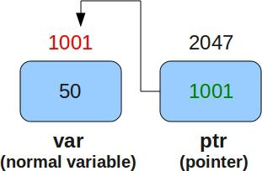
Pointers

Slide 15
Output
Output: 5

Slide 16
Example 2
Int* pc, c; c = 5; pc = &c; c = 1; printf(“%d”, c); printf(“%d”, *pc);

Slide 17
Output
Output-1
Output-1

Slide 18
Example 2
#include <stdio.h> void main() { int * pc, c; c = 22; printf(“Address of c: %p\n”, &c); printf(“Value of c: %d\n\n”, c); pc = &c; printf(“Address of pointer pc: %p\n”, pc); printf(“Content of pointer pc: %d\n\n”, *pc); c = 11; printf(“Address of pointer pc: %p\n”, pc); printf(“Content of pointer pc: %d\n\n”, *pc); *pc = 2; printf(“Address of c: %p\n”, &c); printf(“Value of c: %d\n\n”, c); }

Slide 19
Output
Address of c: 2686784 Value of c: 22 Address of pointer pc: 2686784 Content of pointer pc: 22 Address of pointer pc: 2686784 Content of pointer pc: 11 Address of c: 2686784 Value of c: 2

Slide 20
Sum of 2numbers using pointers
#include <stdio.h> int main() { int first, second, *p, *q, sum; printf(“Enter two integers to add\n”); scanf(“%d%d”, &first, &second); p = &first; q = &second; sum = *p + *q; printf(“Sum of the numbers = %d\n”, sum); return 0; }

Slide 21
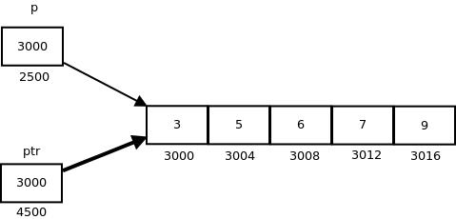
Pointers and Arrays
Double *p; double balance[10]; p = balance;
assigns p as the address of the first element of balance

Slide 22
Sum of elements in an array using pointers
#include<stdio.h> int main() { int array[5]; int i, sum=0; int *ptr; printf(“\nEnter array elements (5 integer values):”); for(i=0;i<5;i++) scanf(“%d”,&array[i]); /* array is equal to base address /* array = &array[0] */ ptr = array; for(i=0;i<5;i++) { //*ptr refers to the value at address sum = sum + *ptr; ptr++; } printf(“\nThe sum is: %d”,sum); }

Slide 23
Largest element in an array
#include<stdio.h> void main(){ int a[10],n,i,max; int *p; clrscr(); printf(“Enter the size of array: “); scanf(“%d”,&n); printf(“Enter %d elements in the array:\n”,n); for(i=0;i<n;i++) scanf(“%d”,&a[i]); printf(“Elements in the array are:\n”); for(i=0;i<n;i++) printf(“%5d”,a[i]); p=&a[0]; max=a[0]; for(i=0;i<n;i++) {if(max<=*p) max=*p; p++;} printf(“\nMaximum element in the array is: %d”,max); }

Slide 24
Structures
structure in C can be used to group items of possibly different types into a single type.
The struct keyword is used to define the structure in the C programming language. The items in the structure are called its member and they can be of any valid data type.
struct structure_name {
data_type member_name1;
data_type member_name1; .... .... };

Slide 25
Example
Struct myStructure { int myNum; char myLetter; };

Slide 26
C Structure Definition
Struct structure_name { data_type member_name1; data_type member_name1; .... .... }variable1, varaible2, ...;
Or
struct structure_name variable1, variable2;

Slide 27
Example
Struct myStructure { int myNum; char myLetter; }s1;
Or
Struct myStructure { int myNum; char myLetter; }; int main() { struct myStructure s1; return 0; }

Slide 28
Access Structure Members
Access structure members by using the ( . ) dot operator.
Structurevariable.structureitem

Slide 29
Example
Struct myStructure { int myNum; char myLetter; }; int main() { // Create a structure variable of myStructure called s1 struct myStructure s1; // Assign values to members of s1 s1.myNum = 13; s1.myLetter = ‘B’; // Print values printf(“My number: %d\n”, s1.myNum); printf(“My letter: %c\n”, s1.myLetter); return 0; }

Slide 30
Example
#include <stdio.h> /*structure declaration*/ struct employee{ char name[30]; int empId; float salary; }; int main() { struct employee emp; printf(“\nEnter details :\n”); printf(“Name ?:”); gets(emp.name); printf(“ID ?:”); scanf(“%d”,&emp.empId); printf(“Salary ?:”); scanf(“%f”,&emp.salary); /*print employee details*/ printf(“\nEntered detail is:”); printf(“Name: %s” ,emp.name); printf(“Id: %d” ,emp.empId); printf(“Salary: %f\n”,emp.salary); return 0; }

Slide 31
Dynamic Memory allocation
Memory allocated during compile time is called static memory.
Fixed &cannot be increased or decreased during runtime.
Process of allocating memory at the time of execution is called Dynamic Memory allocation.
Built in functions that can help in allocating or deallocating some memory space at runtime

Slide 32
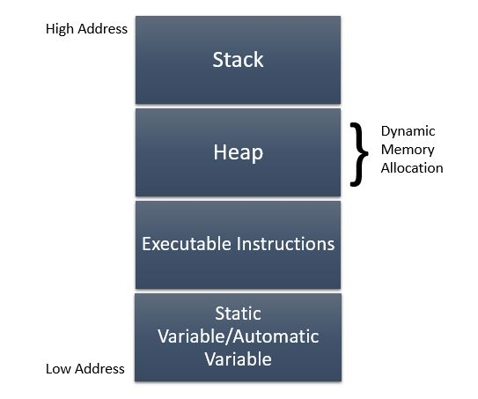
Dynamic Memory allocation

Slide 33
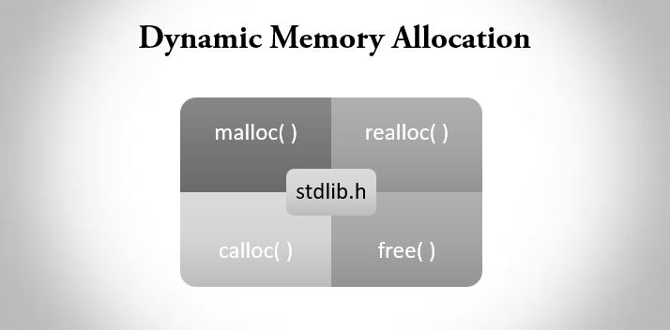
Dynamic Memory allocation-Built in functions

Slide 34
malloc()
Syntax
newPtr = void* malloc( byte-size );
Example: newPtr = (int*) malloc( 10 * sizeof(int) );
Above statement allocates area in the memory that is equivalent to 10 times the size of integer and stores a pointer to the allocated memory in variable newPtr. If the memory space is not available, it returns NULL pointer

Slide 35
malloc()
Allocates single large block of contiguous memory according to the size specified.
On success, it returns a pointer pointing to 1st byte of allocated memory.
If the memory space is not available, it returns NULL pointer.

Slide 36
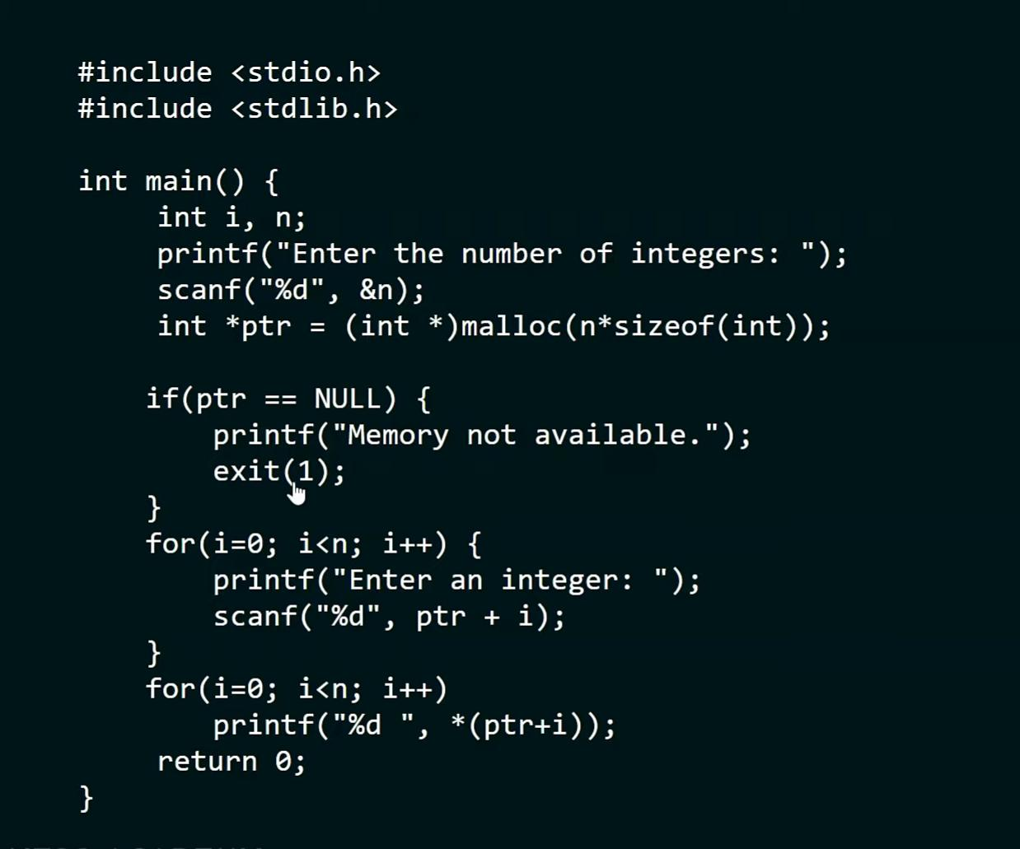
malloc()

Slide 37
calloc
Used to dynamically allocate multiple blocks of memory.
Syntax
newPtr = void* calloc( n, size );
newPtr = pointer of type void n = number of elements size = size of each element
Example:
newPtr = (int*) calloc( 10, size0f(int));

Slide 38
calloc
Difference between malloc and calloc
1) Calloc needs 2arguments.
2)Memory allocated by calloc is initialized to zero, whereas in malloc memory allocation is initialized with some garbage value.

Slide 39
Example
#include <stdio.h>
#include <stdlib.h>
int main()
{
int *ptr;
/* use calloc() function to define the no. of blocks and size of each blocks. */
ptr = calloc (4, sizeof(int)); // here 4 is the no. of block and int is the size of block
if (ptr != NULL)
{
printf (" Memory is created successfully \n");
}
else
printf (" Memory is not created ");
return 0;
}
Output
Memory is created successfully

Slide 40
Example2
#include <stdio.h>
#include <conio.h>
#include <stdlib.h>
void main()
{
int n, *ptr, *p, i, sum = 0;
/* n = number of elements, *ptr = store base address of the dynamic memory,
*p store temporary address of the *ptr */
printf (" Enter the number of elements: ");
scanf (" %d", &n); // it takes number of elements
// use calloc syntax to create memory block of int data type
ptr = (int *) calloc (n, sizeof(int));
p = ptr; // assign the address of ptr

Slide 41
Example
if (ptr == NULL) // it checks whether the memory is allocated { printf (“ Memory is not allocated. “); exit(0); // exit from the program } printf (“ Enter %d numbers \n”, n); for ( I = 1; I <= n; i++) { scanf ( “%d”, ptr); sum = sum + *ptr; ptr++; }

Slide 42
Example
Printf (“ Elements are: “); for (I = 1; I <= n; i++) { printf (“ %d”, *p); p++; } printf (“ \n The addition of the elements is: %d “, sum); getch(); }

Slide 43
realloc()
Used to change size of memory block without losing the old data.
Syntax
Ptr = realloc( Ptr, size );
Ptr = pointer to the previously allocated memory
size = new size
On failure, realloc returns null.

Slide 44
free()
Used to release dynamically allocated memory in heap.
Memory allocated in heap will not be released automatically after using the memory. Space remains there and can’t be used.
It is programmers responsibility to release memory after use
Syntax
void free(ptr) ;

Slide 45
Example
#include <stdio.h> #include <stdlib.h> int main(){ int size, resize, i; int *numPtr; //declaring pointer variable printf(“Please enter size of array: “); scanf(“%d”, &size); //allocation memory for array numPtr = (int*) malloc(size * sizeof(int));

Slide 46
//checking whether memory is allocated or not if(numPtr == NULL) { printf(“\nError !!! (Not enough space)”); exit(0);} printf(“\nEnter array elements:\n”); for(i = 0; i < size; i++){ scanf(“%d”, numPtr + i);} printf(“\nElements of array you entered:\n”); //displaying array elements for(i = 0; i < size; i++){ printf(“%d”, *(numPtr + i));} printf(“\n\nEnter new size of array: “); scanf(“%d”, &resize);

Slide 47
Example
//reallocating array size using new number numPtr= realloc(numPtr, resize * sizeof(int)); if(numPtr == NULL) { printf(“\nError !!! (Not enough space)”); exit(0);} printf(“\n\nElements of resized array:\n”);
array of resized array for(i = 0; i < resize; i++) { printf(“%3d”, *(numPtr + i)); } printf(“\n\n”); free(numPtr); //free reserved memory return 0; }

Slide 48
Self Referential Structures
Structure can have members which point to a structure variable of the same type. • These types of structures are called self referential structures and are widely used in dynamic data structures like trees, linked list, etc.

Slide 49
Self Referential Structures
Struct node {
int data;
struct node *next;
}; Here, next is a pointer to a struct node variable.

Slide 50
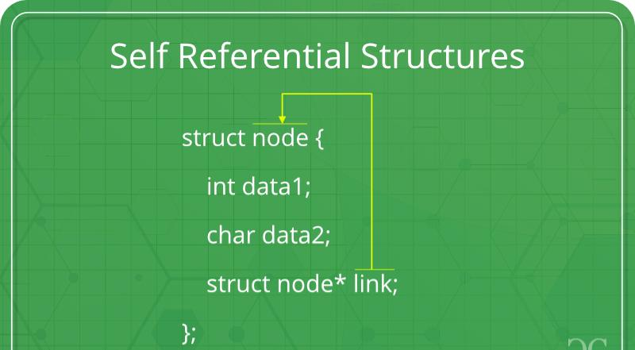
Self Referential Structures

Slide 51
Creation of node
struct node {
int data;
struct node *next; };

